Slide 1
DEEPVSA: Facilitating Value-set Analysis with Deep Learning for Postmortem Program Analysis
Wenbo Guo, Dongliang Mu, Xinyu (X.Y.) Xing, Min Du, Dawn Song
Pennsylvania State University & UC Berkeley
Notes:
Welcome everyone to my talk. My name is wenbo. I will be presenting DEEPVSA.
This is a joint work with my collaborators and advisor from Penn State and UC Berkeley.

Slide 2
Background
Software inevitably contains bugs and vulnerabilities
Remediation requires accurate diagnosis to the root cause of a software failure
Failure diagnosis is a lengthy process because
Failure occurs at post-deployed stage, at which the bad input is typically not available
The information left over for diagnosis is very limited (e.g., a stack trace indicating only part of the functions that have been executed)
Notes:
Modern software inevitably contains bugs.
To fix those bugs, an important step is to reasoning them and finding the root cause.
This process is usually difficult because of the following two reasons.
First, Software failure occurs at post-deployed stage and the bad input is typically not available.
Second, The information left over for diagnosis is very limited

Slide 3
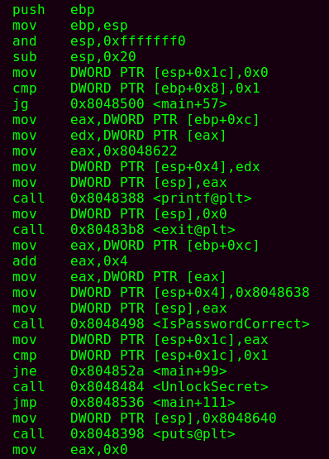
Information Available for Crash Diagnosis
Most broadly used debugging information is still the core dump
After a program crash, computer system generates a core dump file for a crashing process
A core dump typically contains
The memory snapshot of a crashing process
The register values at the time of program crash
The execution trace pertaining to the crashing process (i.e., the critical instructions that can be used to restore the entire instruction trace executed prior to crash)
Mem snapshot + Reg
Execution trace
Notes:
Over the past years, our research community has developed many tools to diagnosis software failures. The information commonly used by these tools is core dump.
A core dump is a file generated after a program crash.
It contains information like memory snapshot and register values of a dead program.
Recently, the development of new hardware also gives～us the capacity to trace program execution.
Therefore, a core dump also contains the execution trace pertaining to the crash process.

Slide 4
Representative Techniques for Crash Diagnosis
Backward taint analysis techniques are broadly used for diagnosing root cause of a software failure
E.g., REPT [OSDI 18]; POMP [USENIX SEC 17]; CREDAL [CCS 16]
The basic idea of backward taint analysis is
Taking as input the snapshot of the crashing memory as well as the full instruction trace
Backpropagating a bad pointer along the execution trace
Pinpointing all the instructions pertaining to the crash
Notes:
Using the core dump i introduced above, diagnosis tool usually utilize backward taint analysis to pinpoint the root cause of a software failure.
The basic idea of backward taint is as follows:
first It takes as input information contains in the core dump.
Starting from a bad pointer, it reversely search along the execution trace and pinpoint all the instructions pertaining to the crash.

Slide 5
Key Challenge of Backward Taint Analysis
Well-designed backward taint requires analyzing memory alias accurately
Inaccurate alias analysis could lead to an over-tainted issue
Over-tainted issue could jeopardize the diagnosis of software crash
Which instructions are the key contributor to the program crash?
Notes:
To perform an~accurate backward taint analysis, alias analysis is usually required.
As you can see here, an~inaccurate alias analysis will lead to Over-taint issue.
This issue could jeopardize the diagnosis of software crash.

Slide 6
Roadmap
Existing technique and challenges of memory alias analysis
Our Proposed approach – DEEPVSA
Experiment Design and Results
Conclusion
Notes:
In this talk, I will first introduce the existing techniques of memory alias analysis and show you the challenges.
Motivated by this. I will then introduce our approach, which leverages the magic of deep learning to identify memory alias and thus facilitate the root cause diagnosis.

Slide 7
Existing approach for memory alias analysis
Value-Set Analysis (VSA) typically partitions memory into 3 disjoint memory regions (stack, heap and global)
VSA determines the regions tied to instructions by using
Instruction semantics
Forward data flow analysis
STACK
…
lea eax,[esp+4]
…
call malloc
…
ret
mov [eax], test
…
mov edx, [0x8050684]
HEAP
GLOBAL
Notes:
value-set analysis is the most popular approach for memory alias analysis.
Technically, it first partitions memory into 3 disjoint regions (stack, heap and global) and then it determines the regions tied to instructions by using two strategies. Instruction semantics and forward data flow analysis.
In particular, for some instructions, VSA could easily complete region assignment based on semantics.
Take the right hand side figure as an example.
VSA could assign instruction line 1 to stack region because of esp register and link the global region to instruction line 5 because of this absolute-address.
For some other instructions, VSA performs a simple forward data flow analysis to determine their memory access regions.
Here, the instruction at line 4 indicates a write to the target memory [eax]. Through a forward data flow analysis, VSA could pinpoint that the value of eax was passed through line 2 vsa can determine that this is a heap access.
(because the library function malloc places its return value in the register eax).

Slide 8
Existing approach for memory alias analysis (cont.)
1 sub esp, 0x14
2 call malloc
......
3 ret
4 mov [eax], test
5 mov [esp+0x8], eax
6 push eax
7 call child
8 push ebp
9 mov ebp, esp
......
Line | A-loc | Value-set
1 | esp | (⊥, [-0x14, -0x14],⊥)
4 | [eax](⊥,[0,0], ⊥) | (test, ⊥, ⊥)
5 | [esp+8](⊥,[-0xC,0xC], ⊥) | (⊥, ⊥, [0, 0])
6 | esp | (⊥,[-0x18,-0x18], ⊥)
 | [esp](⊥,[-0x18,-0x18], ⊥) | (⊥, ⊥, [0, 0])
7 | … | …
… | … | …
Within each region, VSA further estimates the fine-grained region that each instruction attempts to access
For each instruction, VSA uses a 3-tuple to represent the fine-grained region it accesses
Notes:
Within each region vsa assigned, it then estimates the fine-grained region that each instruction attempts to access
As you can see here, each instruction is assigned with 3-tuple. It shows the region and the offset of a memory access
.
For example, -14 indicates that this memory cell accesses the stack region with offset 14.

Slide 9
Software Failure Diagnosis with Facilitation of VSA
Construct a confusion matrix
Use the matrix to compare the overlaps between memory regions
Deem the instructions with nonoverlapped region as non-alias relationships
Perform backward taint analysis under the guidance of identified alias relationship
 | [eax]@4 | [0xC8]@10 | [ebp+0x8]@11 | …
[eax]@4 |  |  |  | …
[0xC8]@10 | Non-alias |  |  | …
[ebp+0x8]@11 | Non-alias | Non-alias |  | …
… | … | … | … | …
1 sub esp, 0x14
2 call malloc
......
3 ret
4 mov [eax], test
5 mov [esp+0x8], eax
6 push eax
7 call child
8 push ebp
9 mov ebp, esp
......
…
Notes:
After assigning instruction to each region, VSA could further facilitate software Failure Diagnosis.
To be specific, it first uses the memory region estimation to construct a confusion matrix.
As you see in this matrix, alias and no-alias relationship are specified.
Finally, We can perform backward taint analysis under the guidance of identified alias relationships and thus pinpoint the root cause.

Slide 10
Practical Issues Observed in the Usage of VSA
Hardware has limited capability in storing all the instructions executed
The execution trace in a core dump is usually incomplete
An incomplete trace influences VSA upon its ability to identify memory alias
STACK
…
lea eax,[esp+4]
…
call malloc
…
ret
mov [eax], test
…
mov edx, [0x8050684]
Which region does [eax] refer to?
HEAP
GLOBAL
Notes:
In the real word, VSA cann’t accurately pinpoint memory alias as we expect. The reason is as follows.
As I mentioned earlier. the log of an execution trace rely on a specific hardware.
However, this hardware has limited capability in storing all the instructions executed.
This means the execution trace in a core dump is usually incomplete.
An incomplete trace will influence VSA upon its ability to identify memory alias.
In the former example, through forward pass, vsa can determine instruction line 4 accesses heap region.
However, without the ability of recording all the instructions, vsa can no longer trace where the value of eax comes from.
As a result, It cannot determine Which region does [eax] refers to.

Slide 11
Roadmap
Existing technique and challenges of memory alias analysis
Our Proposed approach – DEEPVSA
Experiment Design and Results
Conclusion
Notes:
In the following, I will introduce how we design our approach to solve this problem.

Slide 12
Our Proposed Approach -- DEEPVSA
Inspired by the power of deep learning (DL) in other binary analysis applications, e.g.,
Identifying function boundary [USENIX SEC 15]
Recognize function type signatures [USENIX SEC 17]
Use a deep neural network to predict the region that an instruction could access
Utilize the region information to assist traditional VSA in region identification
STACK
HEAP
GLOBAL
Incomplete trace
Deep Neural Net
Incomplete trace + memory regions
VSA
Value set & alias relationship
Notes:
Over the past year, there are many techniques that use dl to perform binary analysis.
Technically, these networks all take the machine code directly as input and output the prediction accordingly.
As I will show later, these network structures can’t achieve very high accuracy because they miss the instruction information.
Inspired by these works, we proposed to use a hierarchical RNN for predicting memory region tied to each instruction in an execution trace.
This diagram here shows the entire process.
First, we train a our nn to predict region and then utilize the region information to assist traditional VSA in memory region identification.

Slide 13
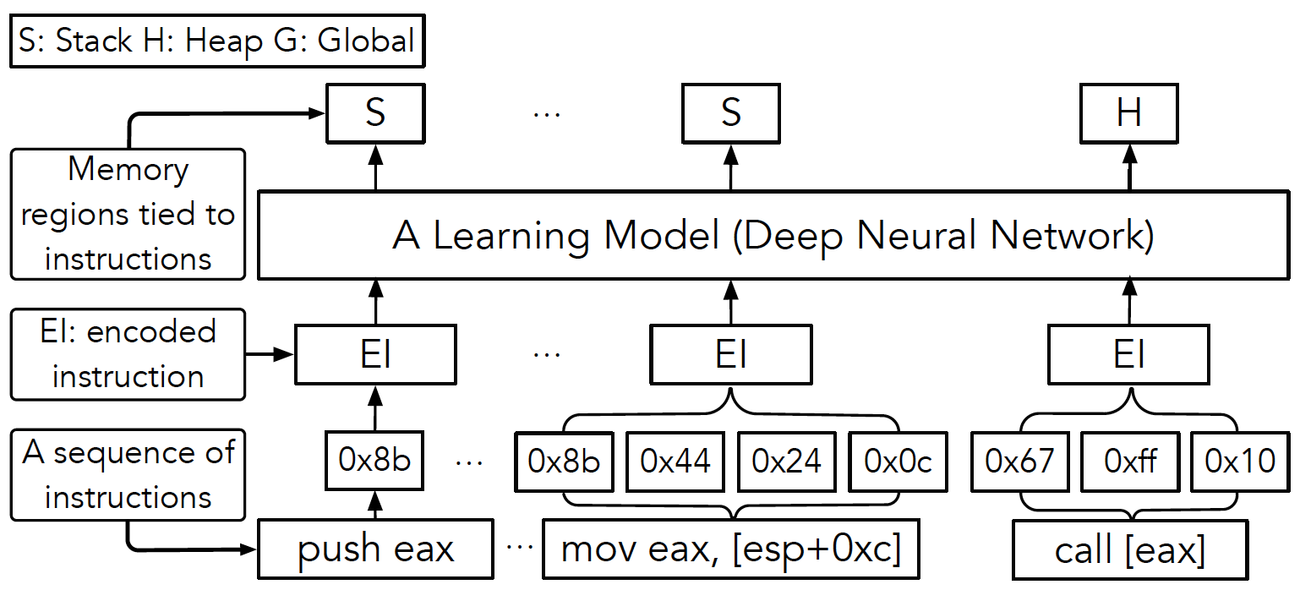
Proposed Neural Network Architecture
Notes:
As to our proposed network.
It takes as input a branch of disassemble machine code.
Then it will transform the machine codes within each instruction into an embedding.
After this step, we will have a sequence of embeddings. And each embedding contains the information of each instruction in this execution trace.
We then input the embedding into a classifier and obtain the predicted region for each instruction.

Slide 14
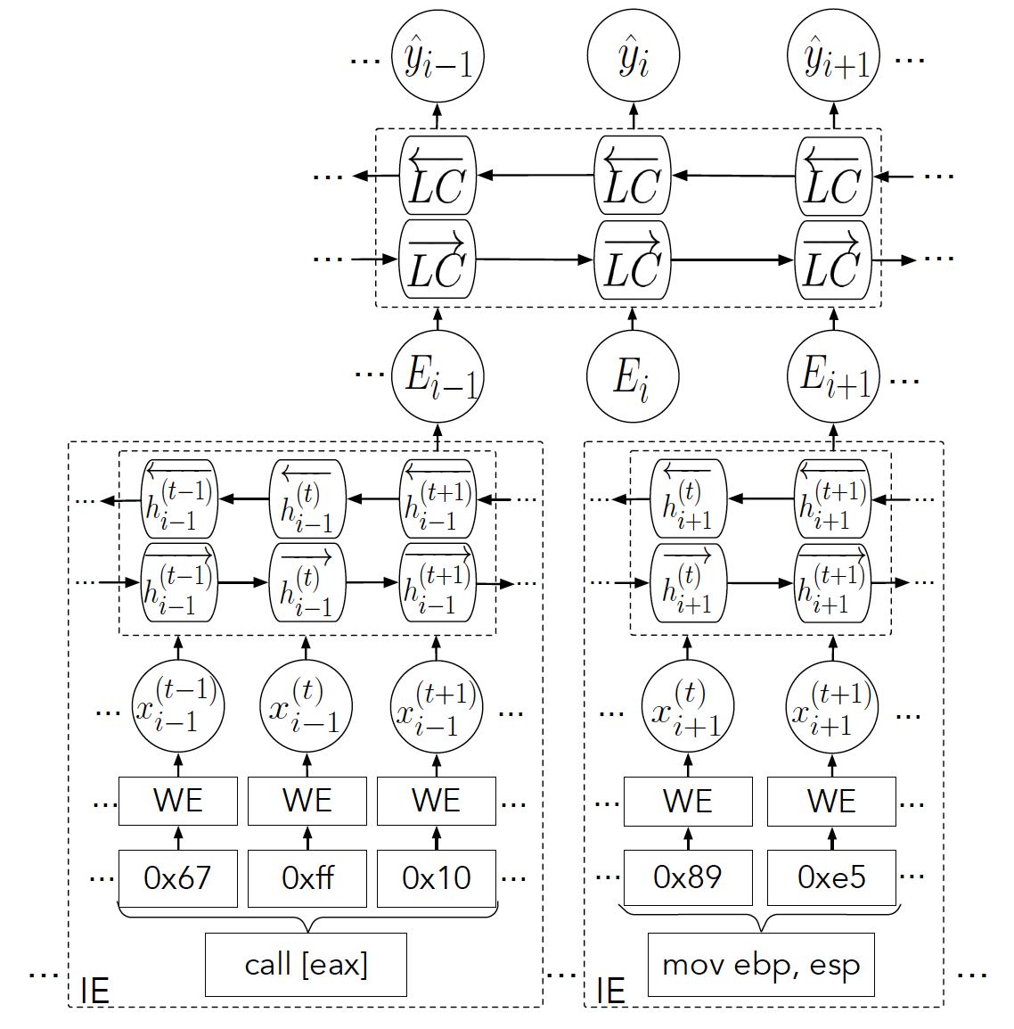
Proposed Neural Network Architecture (cont.)
Instruction Embedding (IE)
Use a word embedding to encode machine code
Use a bi-directional LSTM to generate instruction embeddings
Identification network
Utilize a bi-directional LSTM to predict the region that an instruction accesses
Bi-directional LSTM
Bi-directional LSTM
Word embedding
Notes:
Technically, our network contains two parts instruction embedding network and prediction network.
The embedding network starts with a word embedding mechanism. It will change the discrete instructions into continuous value.
As I mentioned before, The embedding network then transform each instruction into an embedding, which we call it instruction embedding. In particular, we use a bidirectional LSTM to perform the embedding process.
The classification network is also a LSTM.
It takes instruction embeddings as input and output the region information of each instruction.

Slide 15
Roadmap
Existing technique and challenges of memory alias analysis
Our Proposed approach – DEEPVSA
Experiment Design and Results
Conclusion
Notes:
In the rest of this talk, I will introduce how we evaluate our approach.

Slide 16
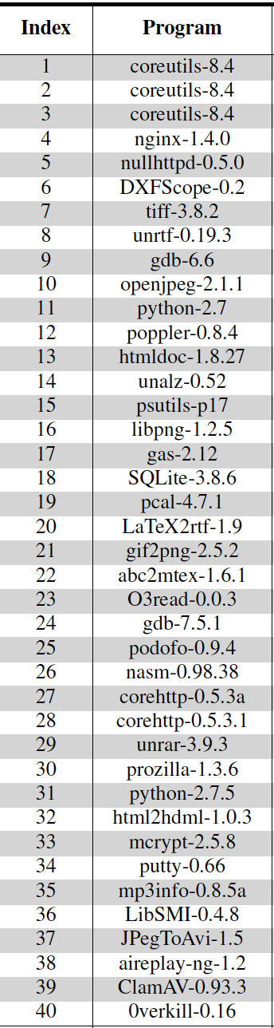
Experiment Dataset
Training set
~50 million lines of instructions and their memory accesses (generated from the test cases of 78 unique programs in a package of GNU software)
Testing set
~1.6 million lines of instructions and their memory accesses (generated from the PoC program of 40 real-world vulnerabilities)
Notes:
Firstly, we construct our training set by using 78 programs in GNU (genu) software. In particular, we ran these programs and gathered their execution traces along with their memory accesses.
To test our trained DNNs, we randomly selected 40 real-world vulnerabilities from Exploit Database Archive. For each vulnerability, we triggered it by running the PoC programs and collect the crashing traces.
These traces have limited size (4KB) due to the limited buffer storage of the hardware.
********
Hardware: Intel PT.
We use Intel pin to collect training traces in the simulation environment.

Slide 17
Experiment Design
Baseline ML models
Hidden Markov Model (HMM)
Conditional Random Field (CRF)
Bi-directional RNN / LSTM / GRU
Evaluation
Model precision, recall and F-measure
DEEPVSA vs. VSA
DEEPVSA vs. a state-of-the-art tool (POMP)
Notes:
we then trained and tested our network by using the data set introduced above and compare it with many other ml models.
Including traditional sequential models such as HMM, CRF and modern DNNs.
In following, I will show you the performance of our approach from three different perspectives.
First, the comparison between our model and the baseline models.
Then, I compare DEEPVSA with VSA in the effectiveness of root cause diagnosis.
Last but not least, I will compare DEEPVSA with another existing root cause diagnosis tool pomp in terms of efficiency.

Slide 18
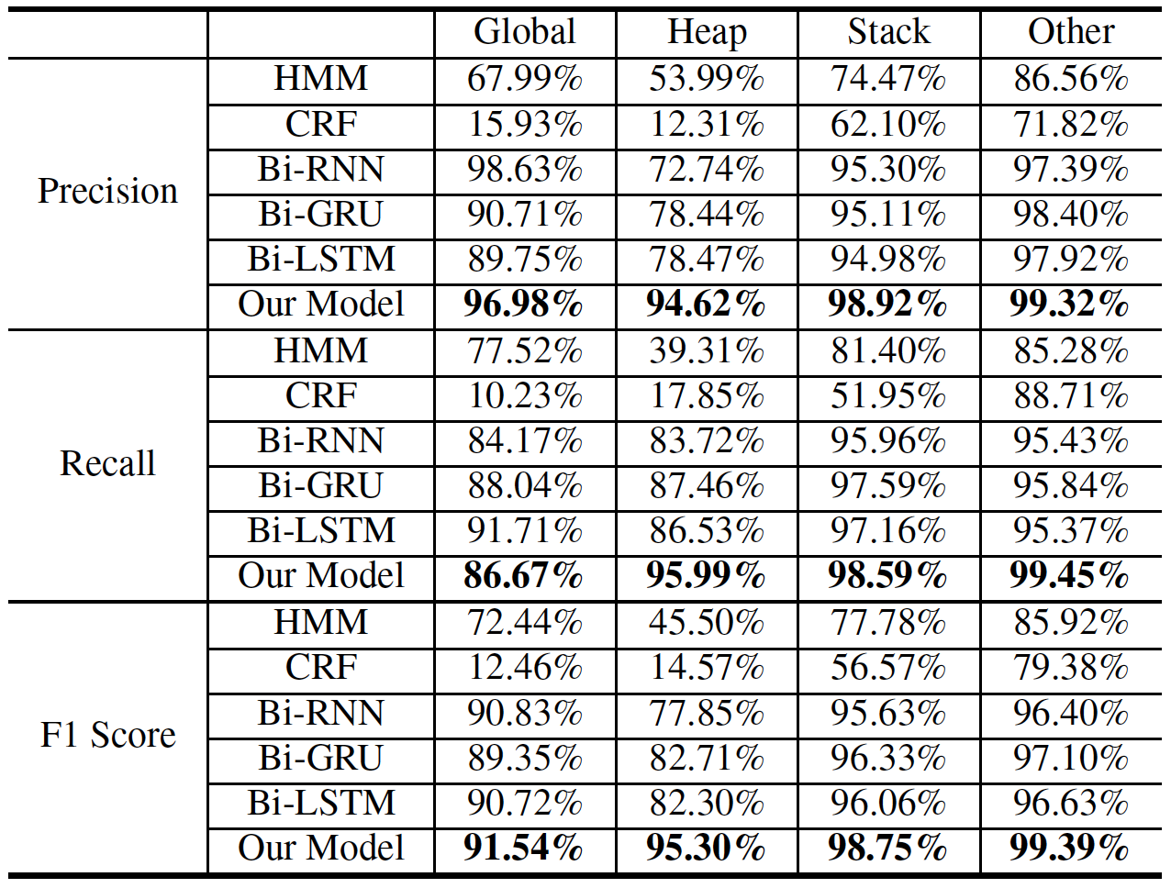
Results – Learning Model Performance
Experiment result summary
Our approach significantly outperforms traditional ML methods (HMM, CRF)
In comparison with other DL approaches, our approach demonstrates slight performance improvement (1% ~ 12%)
Notes:
From this table, we can see that our approach significantly outperforms traditional ML methods.
Compared to other DL based approach, our approach demonstrates slight performance improvement.
This dese not indicate our design is redundant.
In fact, even only 0.1% of improvement in precision, we could reduce the amount of false positives or negatives by thousands.
This amount of improvement in region assignment will increase the alias identification accuracy and thus help root cause diagnosis.

Slide 19
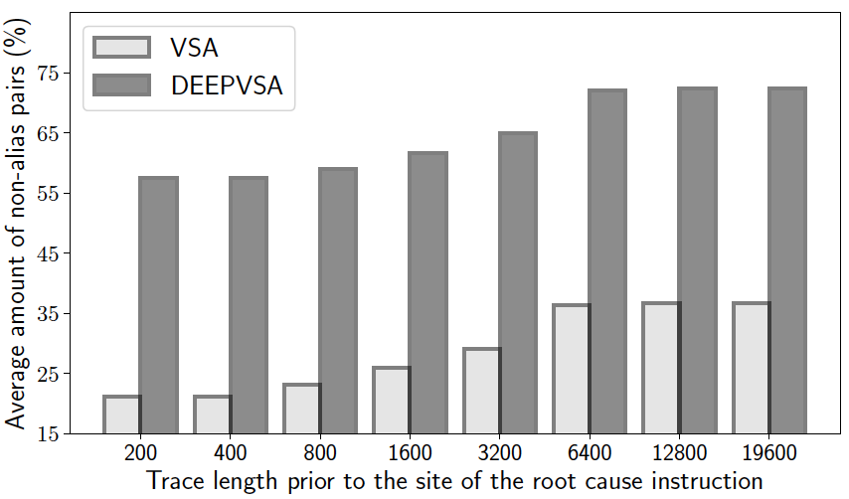
Results – Root Cause Diagnosis (DEEPVSA vs. VSA)
Experiment result summary
Execution trace length stored in a core dump influences alias analysis
In comparison with VSA, DEEPVSA is more effective in finding the root cause of software crashes
 | DEEPVSA | VSA
Total # of cases backward taint pinpoints the root cause of the software crash | 37/40 | 31/40
Notes:
Here is the results of Root Cause Diagnosis.
Recall that we only have limited size of crash traces.
To evaluate the influence of trace length to our approach,
we vary the length of instructions prior to the root cause and record the non-alias pairs identified by our model and traditional vsa.
We can see that execution trace length indeed influences alias analysis to a certain degree.
Across all the settings, our system significantly beat vsa in alias identification accuracy.
As a result, DEEPVSA is more effective in finding the root cause of software crashes.
As you can see in this table, deepvsa could identify 10 more root cause than traditional vsa.
***********
To be specific, we preserve different lengths of instructions prior to the root cause site (i.e., 200, 400, 800, 1600, 3200, 6400, 12800 and 19600) and measure how different lengths impact alias identification

Slide 20
Results – Root Cause Diagnosis (DEEPVSA vs. POMP)
About POMP
POMP is a postmortem program analysis framework [USENIX SEC 17]
POMP diagnoses program crashes using alias analysis and backward taint
The alias analysis of POMP relies upon a reverse execution method which is computationally intensive
Notes:
Last but not least, we compare deepvsa with pomp.
As is mentioned before, pomp also diagnoses program crashes using alias analysis and backward taint. To be specific, it utilizes a reverse execution method to analysis alias. This approach is computationally intensive.

Slide 21
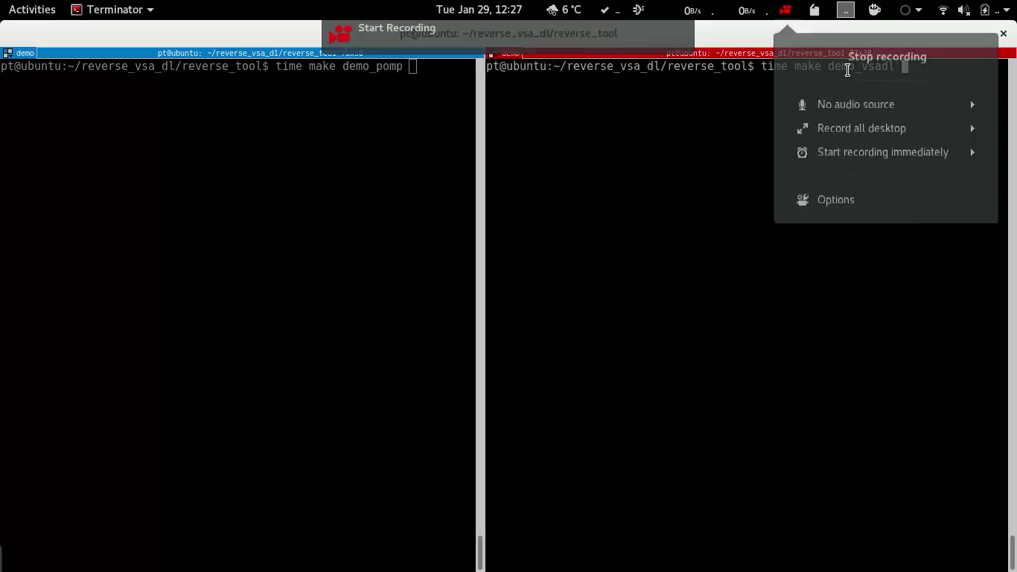
Results – DEEPVSA vs. POMP (cont.)
Experiment results summary
On average, DEEPVSA is 2~10x faster than POMP
Notes:
here is a video to demonstrate the speed difference between pomp and deepvsa.
Actually, DEEPVSA is 2~10x faster than POMP.

Slide 22
Conclusion
Conventional VSA suffers from inaccurate alias analysis when an execution trace is incomplete
VSA combined with deep learning (DEEPVSA) could improve alias analysis in binary analysis and thus facilitate software failure diagnosis
DEEPVSA could serve as an efficient, effective diagnosis tool to pinpoint the root cause of a software failure
Notes:
To conclude this talk.

Slide 23
Thank you very much!
Code and data can be found @ https://github.com/Henrygwb/deepvsa
Notes:
Thank you all for the attention. Now I am glad to take questions.

